Slide 1
Create a model-driven app in Power Apps
Notes:
Model Driven Apps: Learn Module Reference
Introduction to model-driven apps and Dataverse
Getting Started with Microsoft Dataverse
Getting started with Model-Driven apps in Power Apps
Introduction to Dataverse
Create and manage tables in Dataverse
Create and manage columns within an table in Dataverse
Introduction to business process flows in Power Automate
Create an immersive business process flow in Power Automate

Slide 2
Agenda
Introduction to model-driven apps and Microsoft Dataverse
Get started with Dataverse
Get started with model-driven apps in Power Apps
Create and manage columns within a table in Dataverse
Get started with security roles in Dataverse
Document and test your Power Apps application
Notes:
Get started with model-driven apps in Power Apps

Slide 3
Agenda – Continued
Get started with Dataverse for Teams
Build your first app with Dataverse for Teams
Notes:
Get started with model-driven apps in Power Apps

Slide 4

Introduction to model-driven apps and Dataverse

Slide 5
Introduction to the Dataverse
The Dataverse is the foundational data source of Power Platform:
Simple to manage – Metadata and data are stored in the cloud
Helps secure your data – Role-based security allows you to control access to tables for different users within your organization
Access your Dynamics 365 data – Build apps that use your Dynamics 365 data and extend your apps by using Power Apps
Rich metadata – Data types and relationships are used directly within Power Apps
Logic and validation – Define calculated columns, business rules, workflows, and business process flows to ensure data quality and drive business processes
Productivity tools – Tables are available within the add-ins for Microsoft Excel to increase productivity and ensure data accessibility
Notes:
Whether you are building a canvas app or a model-driven app, Dataverse is the ideal data source because it is the foundational data source of Power Platform. As a result, you will experience the most functionality, the deepest integrations, the most features, and the best ease-of-use of any available data sources. From simple web-based data design to robust, role-based security, Dataverse is a straightforward platform that you can use to begin designing your data structures and helping to keep them safe. Then, with your data in place, you have rich integration capabilities from Power Apps and the rest of Power Platform. Additionally, by applying business rules, you can trust that your business integrity will be maintained no matter what tool you use to interact with the data.
Another benefit of using Dataverse is that all of your data is stored in tables. A table is a set of rows that is used to store data, similar to how a table stores data within a database. Dataverse includes a base set of standard tables that cover typical scenarios, but you can also create custom tables that are specific to your organization. Standard and custom tables within Dataverse help provide a secure and cloud-based storage option for your data. Tables allow you to create a business-focused definition of your organization's data for use within apps.
Some benefits of using Dataverse and its tables include:
Simple to manage - Both the metadata and data are stored in the cloud so that you're confident about the details of how they're stored.
Helps secure your data - Data is stored so that users can see it only if you grant them access. Role-based security allows you to control access to tables for different users within your organization.
Access your Dynamics 365 data - If you use Dynamics 365, data from your Dynamics 365 application is also stored within Dataverse, allowing you to quickly build apps that use your Dynamics 365 data and extend your apps by using Power Apps.
Rich metadata - Data types and relationships are used directly within Power Apps.
Logic and validation - Define calculated columns, business rules, workflows, and business process flows to ensure data quality and drive business processes.
Productivity tools - Tables are available within the add-ins for Microsoft Excel to increase productivity and ensure data accessibility.
Simple to manage - Both the metadata and data are stored in the cloud so that you're confident about the details of how they're stored.
Helps secure your data - Data is stored so that users can see it only if you grant them access. Role-based security allows you to control access to tables for different users within your organization.
Access your Dynamics 365 data - If you use Dynamics 365, data from your Dynamics 365 application is also stored within Dataverse, allowing you to quickly build apps that use your Dynamics 365 data and extend your apps by using Power Apps.
Rich metadata - Data types and relationships are used directly within Power Apps.
Logic and validation - Define calculated columns, business rules, workflows, and business process flows to ensure data quality and drive business processes.
Productivity tools - Tables are available within the add-ins for Microsoft Excel to increase productivity and ensure data accessibility.
Now that you have a better understanding of how Dataverse works and are aware of some of the benefits, you can now explore how these benefits can be applied in a model-driven app.

Slide 6
Introduction to model-driven apps
Model-driven apps can be created a few simple steps
Apps are connected to Dataverse:
Rich component-focused, no-code design environments
An ability to create complex responsive apps with a similar UI across a variety of devices from desktop to mobile
Robust design capability
Apps can be distributed as a solution
Notes:
Unlike canvas apps, where you build out an app screen-by-screen by adding logic and code as you go, model-driven apps can be created with a few simple steps. Model-driven apps use a component-focused approach to develop the app. When developing canvas apps, you have complete control over the appearance and behavior of your app, whereas with model-driven apps, the layout is mainly based on the components that you add to the app.
With model-driven apps, a number of different components and component properties are available for you to add and modify when designing an app.
Model-driven app design provides the following benefits:
Rich component-focused, no-code design environments
An ability to create complex responsive apps with a similar UI across a variety of devices from desktop to mobile
Robust design capability
Apps can be distributed as a solution
Rich component-focused, no-code design environments
An ability to create complex responsive apps with a similar UI across a variety of devices from desktop to mobile
Robust design capability
Apps can be distributed as a solution

Slide 7
Dataverse and model-driven apps working together
When creating model-driven apps, it's important to focus on three areas
Modeling business data
Defining business processes
Composing the app
Notes:
When creating model-driven apps, it's important to focus on three areas:
Modeling business data
Defining business processes
Composing the app.
More information on creating model-driven apps is included in the Create relationships, business rules, calculations, and rollups in Dataverse Learning Path and in Overview of building model-driven apps.

Slide 8
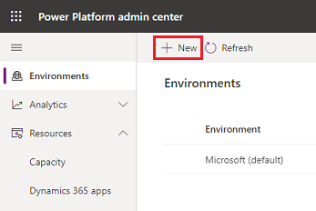
Demo: Sign up and create an environment
Follow lab0 in the Github lab

Slide 9
Exercise: Explore sample template apps
Follow the exercise steps in your student manual in Lesson 1
Notes:
Alternative link https://docs.microsoft.com/en-us/learn/modules/intro-model-driven-apps-common-data-service/4-template-apps

Slide 10

Get started with Dataverse
Notes:
Next we will talk about Building a data model

Slide 11
App data building blocks
Data components determine what data the app will be based upon:
Table: Tables are items with properties that you track
Column: Properties associated with a table and help define the table
Relationship: Defines how tables are related together
Choice column: Lets users select among predefined options
Notes:
When creating model-driven apps, it's important to focus on three areas:
Modeling business data
Defining business processes
Composing the app.
More information on creating model-driven apps is included in the Create relationships, business rules, calculations, and rollups in Dataverse Learning Path and in Overview of building model-driven apps.

Slide 12
Tables
Notes:
https://docs.microsoft.com/en-us/learn/modules/create-manage-tables/1-intro
This lesson has extra coverage for exam purposes from the following link:
https://docs.microsoft.com/en-us/learn/modules/create-manage-entities/

Slide 13



Tables
Data within Dataverse is stored within a set of rows called tables
Dynamics 365
Office 365
Mobile Apps
Web Apps
Power Apps
Power Automate
Power BI
Dataverse
Data connectors
Azure
Notes:
Data within Dataverse is stored within a set of rows called tables. A table is a set of rows used to store data, similar to how a table stores data within a database.
Dataverse includes a base set of standard tables that support common business scenarios that connect to Dynamics 365 application data. You can also create custom tables specific to your organization and populate them with data that you import from lists in SharePoint, from Excel, or from PowerQuery. App makers can then use Power Apps to build rich applications using this data.
Types of tables
The four types of tables are:
Standard - The base set of tables that are created for every instance of a Dataverse database. You can add more columns to any table, but you cannot delete any column from a standard, premium, or restricted table.
Complex - Tables that contain complex, server-side business logic, including real-time workflows or plug-ins. Some of the tables that are used in Dynamics 365 applications are complex. To use complex tables, users are required to have a P2 or Dynamics 365 license. Care must be taken if you add server-side logic to ensure that users have the proper license to use the complex table. Additional information about complex tables can be accessed by following the link within the summary unit of this module.
Restricted - Certain tables that are tied to Dynamics 365 application functionalities require each user to have the corresponding license for that Dynamics 365 application if they want to create, update, or delete rows within the restricted tables. Additional information about restricted tables can be accessed by following the link within the summary unit of this module.
Custom - Are created for a specific business application. All licensed users of Dataverse can access custom tables if they are assigned proper security permissions to do so.

Slide 14
Learn about tables
Tables describe the kinds of data that is stored in Dataverse. (Think of as a table in a database)
Open Houses
Tables contain columns or columns the represent columns in the tables
Clients
Properties
Notes
Consider which Tables will be needed based on your real-life needs
Showings
Notes:
Dataverse is designed to let you quickly and easily create a data model for your application, based on the tables and the table metadata that you include in your app.
Tables describe the kinds of data that is stored in the Dataverse database. Each table corresponds to a database table and each column (also known as a column) within a table represents a column in that table.
In Dataverse, metadata (data about data), is a collection of tables. Table metadata is what controls the kinds of rows you can create and what kind of actions can be performed on them. When you use customization tools to create or edit tables, columns, and table relationships, you are editing this metadata.
The apps that your customers use to interact with the data in your environment depend on the table metadata, and they adapt as you customize the metadata.
When to use standard tables, and when to create new tables?
For minor changes, you might not have to create a custom table:
To change the display name of a column, you can edit the table. You don't have to create a new table.
You can't delete standard tables, but you can hide them. To hide a standard table, change the security role privileges for your organization to remove the Read privilege for that table. This will remove the table from most parts of the application.

Slide 15
Table relationships
Define the different ways table rows can be associated with rows from other tables or the same table:
Room (primary)
One-to-many relationships: Many related child rows associated with a single primary table row in a parent/child relationship
1:N
Session (related)
Many-to-many relationships: Many table rows are associated with many other table rows
Sessions
N:N
Contacts
Hidden Intersect Table
1:N
1:N
Notes:
Table relationships define the different ways table rows can be associated with rows from other tables or the same table. Table relationships are metadata. They let queries retrieve related data very efficiently. Use table relationships to define the formal relationships that define the table or that most rows can use.
When you look at the solution explorer you might think that there are three types of table relationships but actually there are only two, see below:
One-to-many relationships: In a one-to-many (1:N) table relationship, many related table rows are associated with a single primary table row in a parent/child relationship.
Many-to-many relationships: In a many-to-many (N:N) table relationship, many table rows are associated with many other table rows. Rows that are related through N:N table relationships are considered peers.
The N:1 (many-to-one) relationship type exists in the user interface because the designer shows you a view grouped by tables. 1:N relationships actually exist between tables and refer to each table as either a Primary/Current Table or Related Table. The related table, sometimes called the child table, has a lookup column that allows storing a reference to a row from the primary table, sometimes called the parent table. A N:1 relationship is just a 1:N relationship viewed from the related table.
Besides defining how rows can be related to other rows, 1:N table relationships also provide data to address the following questions:
When I delete a row, should any rows that are related to that row also be deleted?
When I assign a row to a new owner, do I also have to assign all related rows to the new owner?
How can I streamline the data entry process when I create a new related row in the context of an existing row?
How should people who view a row be able to view the related rows?
Potential demo: https://docs.microsoft.com/en-us/learn/paths/create-relationships-common-data-service/

Slide 16
Table types
There are two types of tables:
User or team owned: Actions that can be performed on these rows can be controlled at the user level
Organization-owned: Access to the data is controlled at the organization level
Activity Table: Represents an activity that can be added to user/organization tables such as appointments, emails, tasks, etc.
Notes:
Before creating or editing tables in Dataverse, you should understand the different types of tables that you can create. After a custom table is created, the table type can't be changed.
When you create a custom table, the options for ownership are User or team owned, or Organization-owned. After a table is created, you can't change the ownership.
User or team owned: Actions that can be performed on these rows can be controlled at the user level.
Organization-owned: Access to the data is controlled at the organization level.
An activity is an action that a calendar entry can be made for. Activities have these characteristics:
They have time dimensions (start time, stop time, due date, and duration) that help define when the action occurred or will occur.
They have data (like a subject and description) that helps define the action that the activity represents.
They can be opened, canceled, or completed. Several sub-status values will be associated with the Completed status of an activity to clarify how the activity was completed.

Slide 17
Activity table types
Appointment: A commitment representing a time interval that has start/end times and duration
Phone Call: An activity that tracks a telephone call
Email: An activity that's delivered by using email protocols
Recurring Appointment: The master appointment of a recurring appointment series
Fax: An activity that tracks the call outcome and number of pages for a fax
Task: A generic activity representing work that must be done
Letter: An activity that tracks the delivery of a letter. The activity can store an electronic copy of the letter
Notes:
An activity is an action that a calendar entry can be made for. Activities have these characteristics:
They have time dimensions (start time, stop time, due date, and duration) that help define when the action occurred or will occur.
They have data (like a subject and description) that helps define the action that the activity represents.
They can be opened, canceled, or completed. Several sub-status values will be associated with the Completed status of an activity to clarify how the activity was completed.
Business Rules
Business rules provide a simple interface to implement and maintain fast-changing and commonly used rules. The business rules defined for a table apply to both canvas apps and model-driven apps if the table is used in the app.
By combining conditions and actions, you can do any of the following with business rules:
Set column values
Clear column values
Set column requirement levels
Show or hide columns
Enable or disable columns
Validate data and show error messages
Create business recommendations based on business intelligence.

Slide 18
Exercise: Create a table
Follow the exercise in the student manual lesson 3
Notes:
There are several exercises in this module. We recommend that you have students do some of them and you demo the rest.

Slide 19
Get started with model-driven apps in Power Apps

Slide 20
App building blocks
Data: Define the data the app will be based upon
User interface: Determine how users interact with the app
Logic: Determine what business processes, rules, and automation the app will have
Visualization: Determine what type of data and reporting the app will show
Notes:
When creating model-driven apps, it's important to focus on three areas:
Modeling business data
Defining business processes
Composing the app.
More information on creating model-driven apps is included in the Create relationships, business rules, calculations, and rollups in Dataverse Learning Path and in Overview of building model-driven apps.

Slide 21
Data
Data components determine what data the app will be based upon:
Table: Tables are items with properties that you track
Column: Properties associated with a table and help define the table
Relationship: Defines how tables are related together
Choice column: Lets users select among predefined options
Notes:
Tables are items with properties that you track. Examples include contacts and accounts. Many standard tables are available. You can customize a non-system standard table (or production table). You can also create a custom table from scratch.
Columns are properties that are associated with a table and help define that table. A column is defined by a data type, which determines the type of data that can be entered or selected. Examples of data types include text, number, date and time, currency, and lookup (which creates a relationship with another table). Columns are typically used with forms, views, and searches.
Relationships define how tables can be related to each other. There are 1:N (one-to-many), N:1 (many-to-one), and N:N (many-to-many) relationships. For example, adding a lookup column to a table creates a new 1:N relationship between the two tables and lets you add that lookup column to a form.
This type of column shows a control that lets the user select among predefined options. Each option has a number value and a label. Choice columns can require either a single value or multiple values.

Slide 22
User interface
Determine how users will interact with the app:
App: Apps determine the app fundamentals, like components, properties, the client type, and the URL
Site Map: Specifies the navigation of your app
Form: Include a set of data entry columns for a given table
View: Defines how a list of rows for a specific table appear in you app
Notes:
Apps determine the app fundamentals, like components, properties, the client type, and the URL.
A site map specifies the navigation for your app.
Forms include a set of data entry columns for a given table. This set of data entry columns matches the items that your organization tracks for the table. One example is a set of data entry columns where users enter relevant information to track a customer's previous orders together with specific requested reorder dates.
Views define how a list of rows for a specific table appears in your app. A view defines the columns shown, the width of each column, the sort behavior, and the default filters.

Slide 23
Logic
The logic components determine what business processes, rules, and automation the app will have:
Business Process Flow: Walks users through a standard business process
Workflow: Automate business processes without a user interface
Actions: Let you manually invoke actions
Business Rules: Apply rules or recommendation logic to a form
Flows: Lets you create automated workflows between apps
Notes:
Business process flows walk users through a standard business process. Use a business process flow if you want everyone to handle customer service requests the same way. Or you can use a business process flow to require staff to gain approval for an invoice before submitting an order.
Workflows automate business processes without a user interface. Designers use workflows to initiate automation that doesn't require any user interaction.
Actions are a type of process that lets you manually invoke actions, including custom actions, directly from a workflow.
Business rules apply rules or recommendation logic to a form to set column requirements, hide columns, validate data, and more. App designers use a simple interface to implement and maintain fast-changing and commonly used rules.
Power Automate is a cloud-based service that lets you create automated workflows between apps and services to get notifications, sync files, collect data, and more.

Slide 24
Visualization
Determine what type of data and reporting the app will show:
Chart: Individual graphical visualizations that can appear in a view or a form or can be added to a dashboard
Dashboard: Show one or more graphical visualizations that provide an overview of actionable business data
Embedded Microsoft Power BI: Adds embedded Power BI tiles and dashboards to your app
Notes:
Charts are individual graphical visualizations that can appear in a view or a form or that can be added to a dashboard.
Dashboards show one or more graphical visualizations that provide an overview of actionable business data.
Power BI adds embedded Power BI tiles and dashboards to your app. Power BI is a cloud-based service that provides business intelligence (BI) insight.

Slide 25
Designing model-driven apps
When designing your Power Apps solution, consider:
Business Requirements: Work with app stakeholders to consider your security, accessibility, data, and design needs
Data Model: What data are you storing and collecting, and how does it relate to other data you are working with?
Business Logic: Are there any processes we need to address, or need to enforce?
Output: How should will the data be visualized in the application
Accelerators: Are there any third-party solutions or data accelerators that we can leverage?
Notes:
Design model-driven apps
As an App Maker, before you begin building your Power Apps solution, it’s recommended to go through a design process. When designing your Power Apps solution, there are several different factors to consider:
Business requirements
Data Model
Business Logic
Output
By going through a simple design process, you can flush out any minor issues before they become a larger problem once the app is in production.

Slide 26
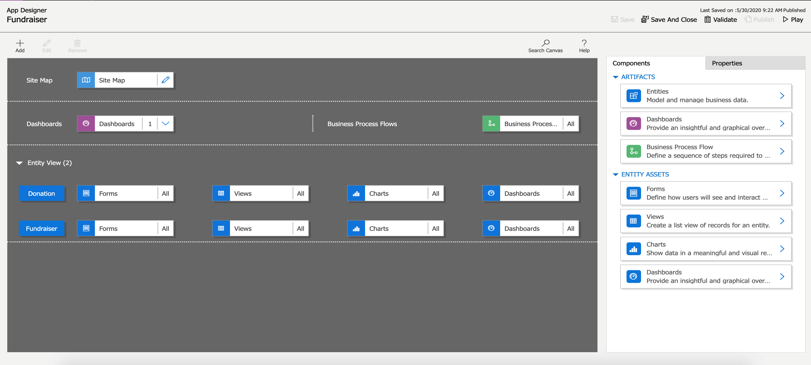
Designing model-driven apps
Here is a quick look at the app Designer for an example app called “Fundraiser”
Notes:
Design model-driven apps
As an App Maker, before you begin building your Power Apps solution, it’s recommended to go through a design process. When designing your Power Apps solution, there are several different factors to consider:
Business requirements
Data Model
Business Logic
Output
By going through a simple design process, you can flush out any minor issues before they become a larger problem once the app is in production.
Understand the needs of the user
With Model-driven apps, the name says it all. Your primary design goal is to get your Dataverse data model in order. With that in place, you can connect Power Apps, and a Model-driven app will be created for you from that model.
Model-driven apps are created using the App Designer. You will choose the tables, dashboards, Business Process flows, forms, and other components that you want to make available in your app, and then the app will be created for you. This means you will need to spend more time understanding what your user needs than how it is going to look.
Business Requirements
The first step in the process is to understand your business requirements. Work with the app stakeholders to consider your security, accessibility, data, and design needs.
For security, the Dataverse has a robust security model. You will want to consider how securing your app’s data affects your app and what security model best supports your business needs. There are lots of options available, including hierarchy security, row-level security, to name a few. You will need to confirm your data is secured to meet your needs, and then your app will honor that security.
During this process, you will also want to identify any government regulations or authentication/authorization requirements (if applicable). You may want to implement multi-factor authentication but will need to think about how this will affect users connecting to your application. You don’t necessarily have to have all the answers to your questions here; you just want to flush out all of the requirements.
Finally, does your app need to be available when the user is disconnected from the internet? This is called Offline Mode and is supported by the Dataverse and Model-driven apps when using iOS or Android clients. It does require additional design considerations that we will touch on very briefly later.
Data Model
As you begin the data modeling process, there are a couple of important questions to ask yourself:
What type of data will your solution be storing and or collecting?
How will this data relate or coincide with the other data you are working with?
These questions are important when designing a model-driven application because of how model-driven applications function. Remember, model-driven applications use a metadata-driven architecture. This means a large portion of the model-driven app is based on how your data is modeled, and there is no need to write custom code to alter the app design. To expand on this a little further, when thinking about Metadata this simply means “data about data” and this data defines the structure stored in the system.
You can view the app metadata by reviewing the Table in the Dataverse.
You can also view the app metadata by putting the app in Play mode.
In the example above, for the Fundraiser Table, there are several pieces of metadata being collected, such as:
Name
Fundraiser Goal
Owner
Total Donations
Created On
Each solution you develop and deploy will have its own set of metadata to collect. This basic understanding of metadata is important as you continue the design process and modeling your app data.
As you think about your data model also think about column types. When adding columns to your table in the Dataverse, the column type you choose will determine how users enter and view that in your Model-driven app. Choices show as dropdowns, currency shows with currency symbols, while decimal numbers don’t. These little changes in the table can have a profound effect on how your user experiences your app.
[!NOTE] If a column type needs to be changed to a different column type, (i.e. text column to a choice), then you will need to delete that column and recreate with the correct column type. This will cause you to lose any data associated with that column.
User Interface (UI) and User Experience (UX)
When building a Model-driven app, most of the UI and UX are predetermined for you. You define the data model to build from, and then Power Apps determines the controls used in the app. You can influence these controls by determining what table assets you include. You define in the App Designer What Forms, Views, Charts, and Dashboards are used in the app. You also control the navigation options via the Site Map. As you are planning your app, determine which components are needed in the app design, and create them before building your app.
To continue building off of the example we’ve been using throughout this module, below is a simple Model-driven Form, which captures various pieces of information for creating a New Fundraiser.
Here is an example of what the New Fundraiser form looks like when editing from the App Designer.
Business Logic
When incorporating business logic in your app, there are two primary options available. You can set Business Rules on your Dataverse tables or you can build Business Process Flows.
With Business Rules, you will define behaviors at the data layer. This is great for changing when a column is required, setting a default value, or even showing or hiding a column based on a criteria. An example could be a table for tracking expenses. You could have a column for type of travel and then build a business rule that says if they choose automobile then the mileage column is required, else it is optional. This gives you great power to make sure you maintain data consistency in all scenarios.
Business Process Flows are used to guide users through using your app. These workflows can provide visuals on next steps based on the status of the data and facilitate other actions that you want to occur as the user uses the app. Business Process Flows let you bring automation to your app and make it more of a guided experience than just a place to enter data.
Output
A common output need for apps is to visualize the data. For this requirement, you can implement Dashboards with custom filters and visual graphics to tie all of this data together right in your app. When creating your Dashboards, make sure it’s simple for your users to consume without overwhelming them with all the data. Provide high-level snapshots of your data and allow them to use filters to dive deeper into the data if needed.
Additional third-party solutions and app accelerators
It is also important to know about the different App accelerators and third-party solutions available to you. Depending on the industry you are in, Health, Financial, Banking, Education, Non- Profit, Automotive, or Media, Microsoft has released a number of accelerators or foundational components to assist you with quickly standing up your solution. For more information, see Industry accelerators overview link in the student manual.

Slide 27
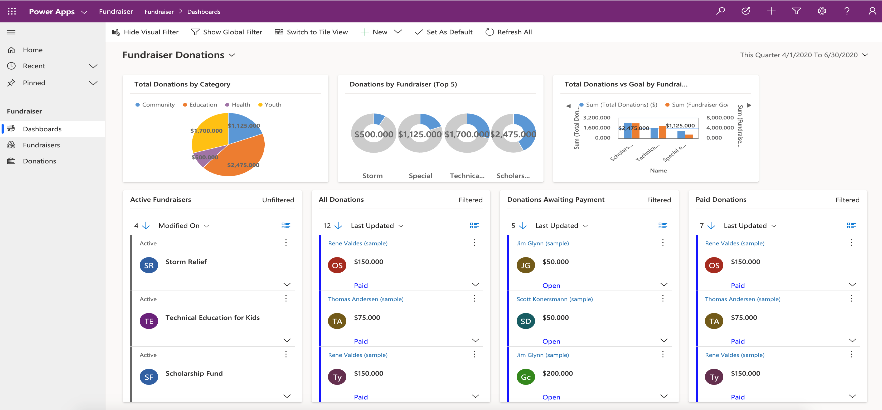
Designing model-driven apps
When the app is put into Play Mode, it looks completely different.

Slide 28

Business requirements
Work with the app stakeholders to consider your security, accessibility, data, and design needs.
Consider how securing your app’s data affects your app and what security model best supports your business needs
Identify any government regulations or authentication/authorization requirements
Does your app need to be available when the user is disconnected from the internet?
Notes:
The first step in the process is to understand your business requirements. Work with the app stakeholders to consider your security, accessibility, data, and design needs.
For security, the Dataverse has a robust security model. You will want to consider how securing your app’s data affects your app and what security model best supports your business needs. There are lots of options available, including hierarchy security, row-level security, to name a few. You will need to confirm your data is secured to meet your needs, and then your app will honor that security. During this process, you will also want to identify any government regulations or authentication/authorization requirements (if applicable). You may want to implement multi-factor authentication but will need to think about how this will affect users connecting to your application. You don’t necessarily have to have all the answers to your questions here; you just want to flush out all of the requirements.
Finally, does your app need to be available when the user is disconnected from the internet? This is called Offline Mode and is supported by the Dataverse and Model-driven apps when using iOS or Android clients. It does require additional design considerations. We will briefly talk about it later.

Slide 29
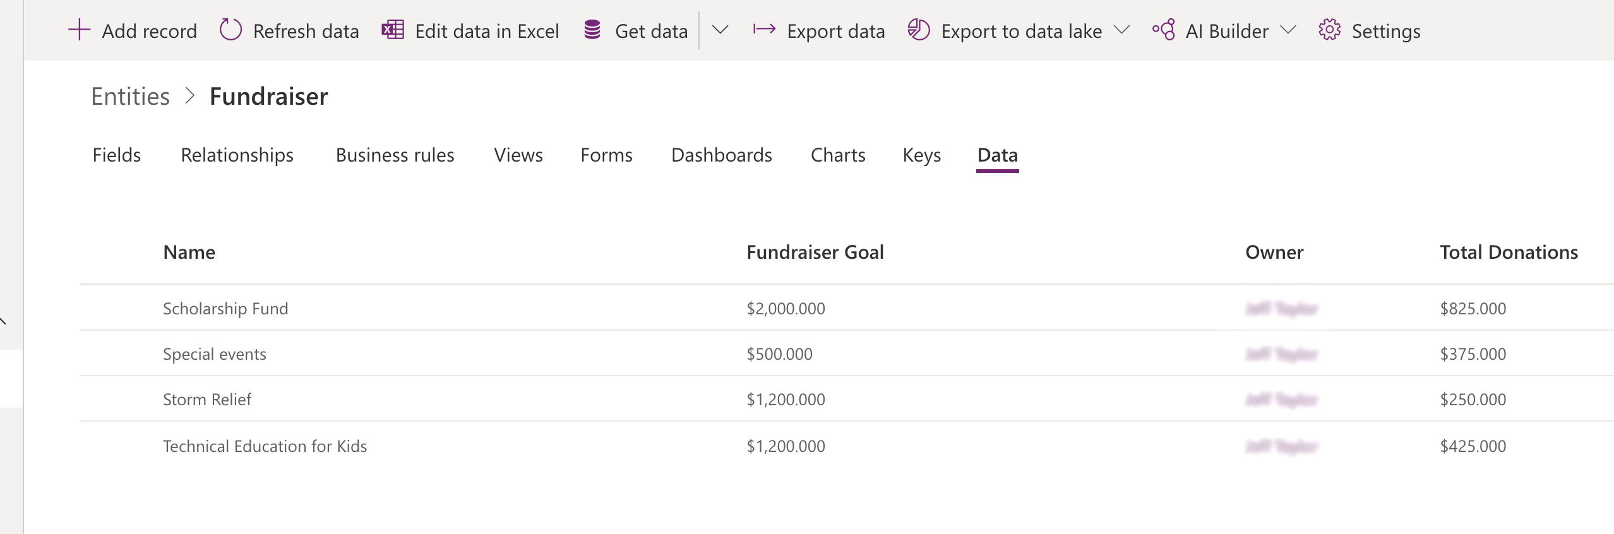
Data Model
You can view the app metadata by reviewing the Table in the Dataverse.
Notes:
As you begin the data modeling process, there are a couple of important questions to ask yourself:
What type of data will your solution be storing and or collecting?
How will this data relate or coincide with the other data you are working with?
These questions are important when designing a model-driven application because of how model-driven applications function. Remember, model-driven applications use a metadata-driven architecture. This means a large portion of the model-driven app is based on how your data is modeled, and there is no need to write custom code to alter the app design. To expand on this a little further, when thinking about Metadata this simply means “data about data” and this data defines the structure stored in the system.
You can view the app metadata by reviewing the Table in the Dataverse.
You can also view the app metadata by putting the app in Play mode.
In the example above, for the Fundraiser Table, there are several pieces of metadata being collected, such as:
Name
Fundraiser Goal
Owner
Total Donations
Created On

Slide 30
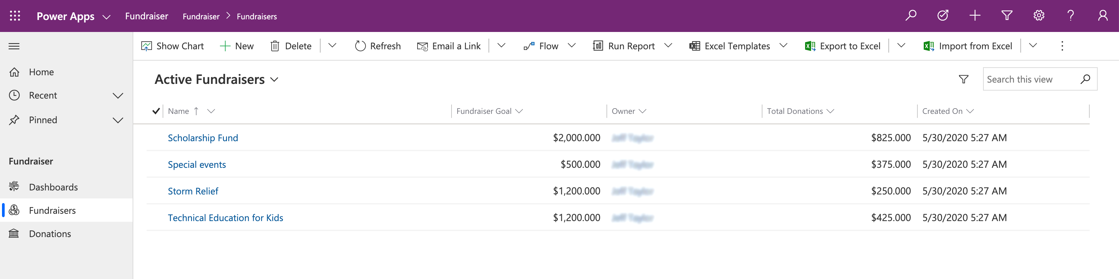
Data Model
You can also view the app metadata by putting the app in Play mode.
Notes:
As you begin the data modeling process, there are a couple of important questions to ask yourself:
What type of data will your solution be storing and or collecting?
How will this data relate or coincide with the other data you are working with?
These questions are important when designing a model-driven application because of how model-driven applications function. Remember, model-driven applications use a metadata-driven architecture. This means a large portion of the model-driven app is based on how your data is modeled, and there is no need to write custom code to alter the app design. To expand on this a little further, when thinking about Metadata this simply means “data about data” and this data defines the structure stored in the system.
You can view the app metadata by reviewing the Table in the Dataverse.
You can also view the app metadata by putting the app in Play mode.
In the example above, for the Fundraiser Table, there are several pieces of metadata being collected, such as:
Name
Fundraiser Goal
Owner
Total Donations
Created On

Slide 31
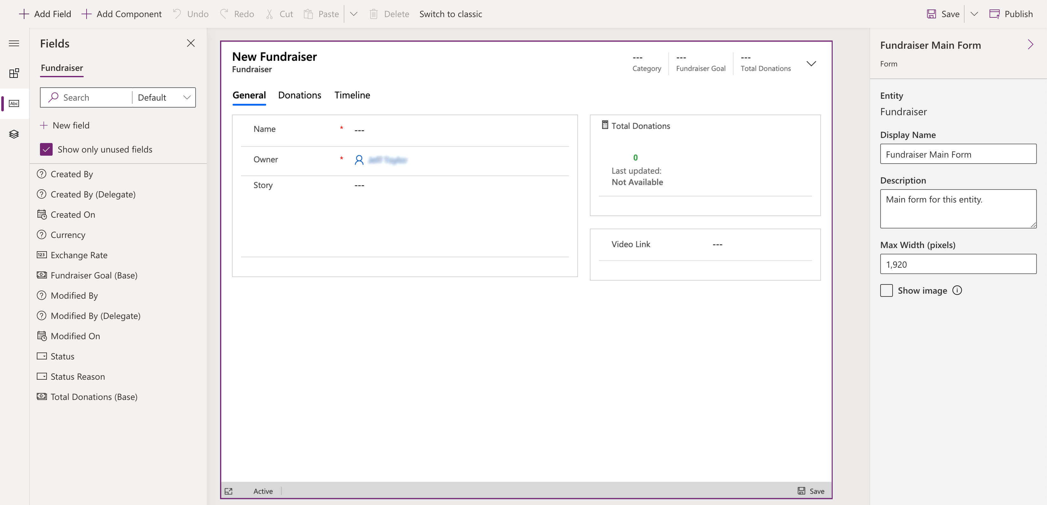
User Interface (UI) and User Experience (UX)
Here is an example of what the New Fundraiser form looks like when editing from the App Designer.
Notes:
When building a Model-driven app, most of the UI and UX are predetermined for you. You define the data model to build from, and then Power Apps determines the controls used in the app. You can influence these controls by determining what table assets you include. You define in the App Designer What Forms, Views, Charts, and Dashboards are used in the app. You also control the navigation options via the Site Map. As you are planning your app, determine which components are needed in the app design, and create them before building your app.
To continue building off of the example we’ve been using throughout this module, below is a simple Model-driven Form, which captures various pieces of information for creating a New Fundraiser.

Slide 32

Business Logic and Output
Here is an example of what the New Fundraiser form looks like when editing from the App Designer.
Notes:
When incorporating business logic in your app, there are two primary options available. You can set Business Rules on your Dataverse tables or you can build Business Process Flows.
With Business Rules, you will define behaviors at the data layer. This is great for changing when a column is required, setting a default value, or even showing or hiding a column based on a criteria. An example could be a table for tracking expenses. You could have a column for type of travel and then build a business rule that says if they choose automobile then the mileage column is required, else it is optional. This gives you great power to make sure you maintain data consistency in all scenarios.
Business Process Flows are used to guide users through using your app. These workflows can provide visuals on next steps based on the status of the data and facilitate other actions that you want to occur as the user uses the app. Business Process Flows let you bring automation to your app and make it more of a guided experience than just a place to enter data.
Output
A common output need for apps is to visualize the data. For this requirement, you can implement Dashboards with custom filters and visual graphics to tie all of this data together right in your app. When creating your Dashboards, make sure it’s simple for your users to consume without overwhelming them with all the data. Provide high-level snapshots of your data and allow them to use filters to dive deeper into the data if needed.

Slide 33
Additional third-party solutions and app accelerators
Microsoft is currently focused on delivering accelerators for the following industries, with others to come:
Automotive
Financial services,
including banking and insurance
Healthcare
Education,
including higher education and K–12
Nonprofit
Manufacturing,
media and communications
Notes:
It is also important to know about the different App accelerators and third-party solutions available to you. Depending on the industry you are in, Health, Financial, Banking, Education, Non- Profit, Automotive, or Media, Microsoft has released a number of accelerators or foundational components to assist you with quickly standing up your solution. For more information, see Industry accelerators overview in the student manual reference link.

Slide 34
App module components
Site navigation
Dashboards
Business process flows
Forms
Views
Charts

Slide 35
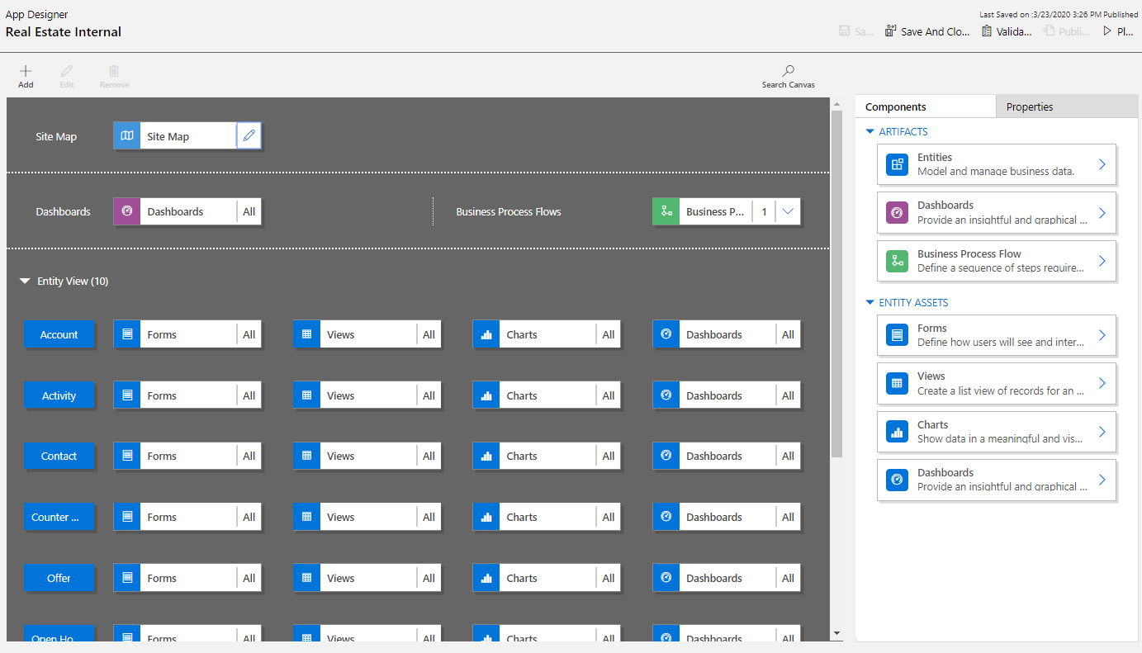
Working with the App Designer
Application navigation is controlled by editing the sitemap
All table Forms, Views, Charts, & Dashboards will be included
Items can be removed to include only what is needed for the app

Slide 36
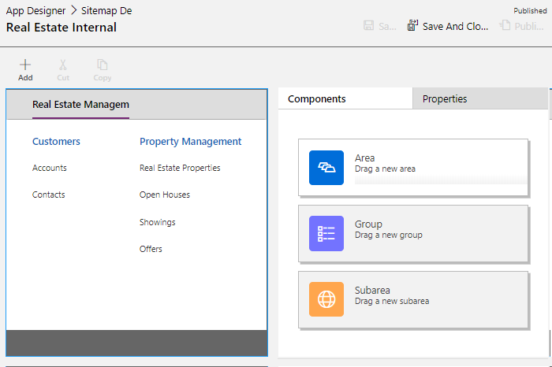
Working with the site map designer
App module Site Maps are separate from the default navigation
When table is added to Site Map a dependency is added to the app module
Publishing App Module also publishes any Site Map changes

Slide 37
Exercise: Create a model-driven app
Follow the exercise in the student manual in lesson 2
Notes:
https://docs.microsoft.com/en-us/learn/modules/get-started-with-model-driven-apps-in-powerapps/3-create-a-model-driven-app

Slide 38
Incorporate business process flows
Notes:
Link: https://docs.microsoft.com/en-us/learn/modules/intro-business-process-flows/ Incorporate business process flows
You can help ensure that people enter data consistently and follow the same steps every time they work with a customer by creating a business process flow.
For example, you might want to create a business process flow to have everyone handle customer service requests the same way, or to require that people get approval for an invoice before submitting an order. Business process flows use the same underlying technology as other processes, but the capabilities that they provide are very different from other features that use processes. We will cover it in details in the Power Automate module.

Slide 39
Exercise: Create a Model Drive App - Scenario
Follow the scenario exercise in the student manual in lesson 2
Notes:
Exercise or potential demo
https://docs.microsoft.com/en-us/learn/modules/get-started-with-model-driven-apps-in-powerapps/5b-create-model-driven-application

Slide 40
Packaging application components for distribution
Notes:
This lesson is an add-on for exam coverage purposes

Slide 41
Solutions overview
Solutions are a container to track the changes you make to the Dataverse, Power Apps and Power Automate flows
Solutions are how you transport and install changes to target environments
Development
Test
Production
Microsoft Dynamics 365 apps are installed using solutions:
3rd party apps provided by Independent Software Vendors (ISVs) also use solutions
Notes:
Solutions are containers that track and manage customizations in a Dataverse environment
If you have multiple environments, each would have their own set of solutions. Solutions can include table metadata, forms, views, business rules, processes definitions and other assets required to run the app; including components created by developers like scripts or compiled code.
when you have a Dynamics 365 application like Sales or Service those are installed using the same solution framework. 3rd party ISVs also ship their products using solutions

Slide 42
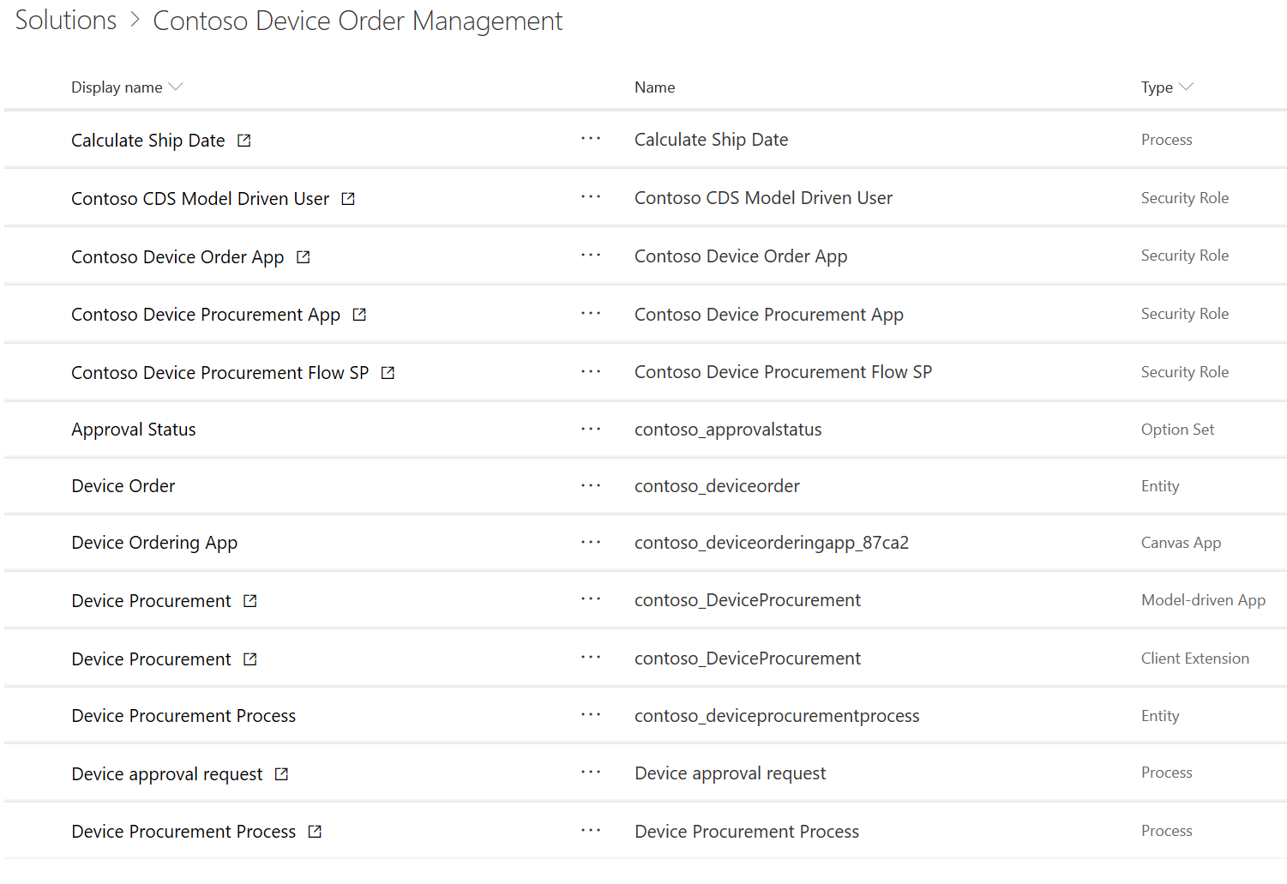
Contoso device ordering solution example
Solution – Device Ordering
Apps
Data (Tables)
Processes
Device Ordering
Device Order
Order Approval Flow
Device Procurement
Device Procurement Process
Security Roles
Device Ordering App role
Device Procurement App role
Device Procurement Flow role
Notes:
This is app in a day scenario

Slide 43
Types of solutions
Unmanaged:
Used during development
Used to transport to other development environments
Managed:
Used to distribute to non-development environments
Notes:
Prescribed method is to deploy managed solutions. You should ensure that you have unmanaged solutions in a form of source control and not rely on the dev environment as source control.

Slide 44
Solution components
Solution components are categorized to track the individual items associated with the solution
Component types include tables, apps (model and canvas), Power Automate flows, security components as well as developer assets
Some components are sub-components, for example forms, views, charts, and columns are all sub-component of tables
Reference data is not included as a solution component
Notes:
"When making changes or creating new components you should always start from within the custom solution you created for your project."

Slide 45
Demonstration: Create a solution

Slide 46
Create and manage columns within a table in Dataverse

Slide 47
Columns
Text
Text area
Email
URL
Ticker symbol
Phone
Whole number
Duration
Time zone
Language
Currency
Decimal number
Floating point number
Image
Choices
Multiline text
Choice
Yes/No
Notes:
Text - A text value intended to be displayed in a single-line text box.
Text Area - A text value intended to be displayed in a multi-line text box. If you require more than 4,000 characters, use a Multiline Text data type.
Email - A text value that is validated as an email address and rendered as a mailto link in the column.
URL - A text value that is validated as a URL and rendered as a link to open the URL.
Ticker Symbol - A text value for a ticker symbol that will display a link that will open to show a quote for the stock ticker symbol.
Phone - A text value that is validated as a phone number rendered as a link to initiate a phone call by using Skype.
Whole Number - A number value presented in a text box.
Duration - A number value presented as a drop-down list that contains time intervals. A user can select a value from the list or type an integer value that represents the number of minutes.
Timezone - A number value presented as a drop-down list that contains a list of time zones.
Language - A number value presented as a drop-down list that contains a list of languages that have been enabled for the environment. If no other languages have been enabled, the base language will be the only option. The saved value is the Locale Identifier (LCID) value for the language.
Currency - A money value for any currencies that are configured for the environment. You can set a level of precision, or you can choose to base the precision on a specific currency or a single standard precision that is used by the organization.
Decimal Number - A decimal value with up to 10 points of precision. See Using the right type of number for more information.
Floating Point Number - A floating point number with up to 5 points of precision. See Using the right type of number for more information.
Image - Displays a single image for each row in the application. Each table can have one image column. The name that you enter when creating an image column will be ignored. Image columns are always named TableImage. You can only have one image column for each table.
Choices - Displays a list of options where more than one option can be selected.
Multiline Text - A text value intended to be displayed in a multi-line text box. This value is limited to a maximum of 1,048,576 characters. You can also set a lower Max Length.
Choice - Displays a list of options where only one can be selected.
Yes/No - Displays Yes/No where only one can be selected. You can choose which labels are displayed for each option. The default values are Yes and No.

Slide 48
Calculated & rollup columns
Data Type | Simple | Calculated | Rollup
Single Line of Text | × | ×
Multiple Lines of Text | ×
Whole Number | × | × | ×
Floating Point | ×
Decimal | × | × | ×
Currency | × | × | ×
Date Time | × | × | ×
Choice/Yes/No | × | ×
Multi-Select | ×
Notes:
Simple: What we had before previous versions, straight forward data columns
Calculated: Values calculated with expression for columns on current and parent row
Rollup: Values are calculated by querying child rows of a 1:N relationship

Slide 49
Date behavior options
User Local (how it was)
Date only
Time zone Independent
Stores in UTC
Date Only
No time zone conversion
Converts to user’s local time zone for display
Time is always 12:00am
No time zone conversion
Notes:
Now supports Date and Time values back to 1/1/1753
You can quiz the audience: where 1/1/1753 in Dynamics 365 is not enough and what to do? E.g. birthdays of famous people, real estate in Europe
Per https://technet.microsoft.com/en-us/library/dn946904.aspx that "In the user interface (UI), you can change certain out-of-the-box table column’s behavior from the User Local to Date Only"

Slide 50
Calculated vs. Rollup
Calculated
Rollup
Calculated on retrieve of row
Value stored on row, scheduled update/on-demand
Read only column
Read only column
Row columns and parent columns
1:N only, columns on child rows
Can include rollup columns in calculation
Can rollup calculated columns
No OOB calculated columns
Can use hierarchy of related rows
Can filter across related tables
Notes:
You can rollup "simple" calculated columns, e.g. calculated columns that include non-deterministic functions cannot be rolled up

Slide 51
Restrictions that apply to columns in a table
As a rule, you should have less than a few hundred columns in a table:
Rollup columns:
Max of 100 for each organization
Max of 10 for each table
Primary Name column:
You can only have one primary column for each custom table
Searchable columns:
You can only have five searchable columns for each table
Notes:
Data within Dataverse is stored within a set of rows called tables. A table is a set of rows used to store data, similar to how a table stores data within a database.
Dataverse includes a base set of standard tables that support common business scenarios that connect to Dynamics 365 application data. You can also create custom tables specific to your organization and populate them with data that you import from lists in SharePoint, from Excel, or from PowerQuery. App makers can then use Power Apps to build rich applications using this data.

Slide 52
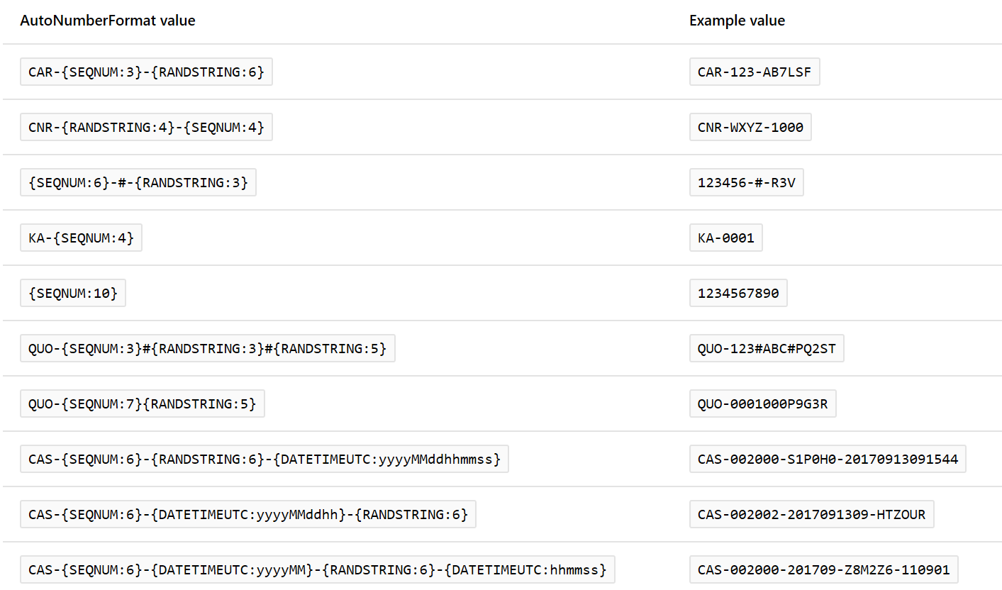
Auto numbering
You can create the following number columns:
String prefixed number
Date prefixed number
Custom
Notes:
String prefixed number - The most common auto number format is a simple string prefixed number. When this type is selected, the autonumber will consist of an automatically incrementing number with an optional string constant prefix. For example, a string prefixed number with the prefix of Contoso would generate rows such as Contoso-1000, Contoso-1001, Contoso-1002, and so on.
Date prefixed number - Another common auto number format is a date prefixed number. When this type is selected, the auto number will consist of an automatically incrementing number with a formatted date prefix. The date portion of the row will reflect the current date and time at which the row was created in UTC time. For example, a date prefixed number would generate rows such as 2019-26-02-1000, 2019-27-02-1000, 2019-28-02-1000, and so on, depending on the current date and selected date format.
Custom - For more advanced makers with specific use cases, you have the option to fully customize the desired format of an autonumber column. The format might consist of string constants, automatically incrementing numbers, formatted dates, or random alphanumeric sequences. For detailed information about how to define custom formats, see AutoNumberFormat options.

Slide 53
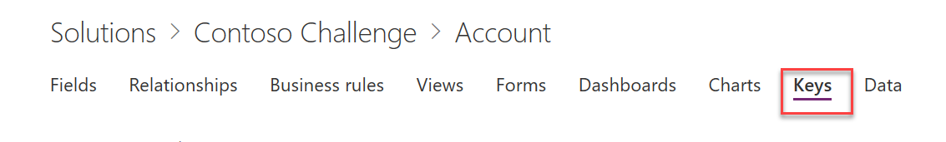
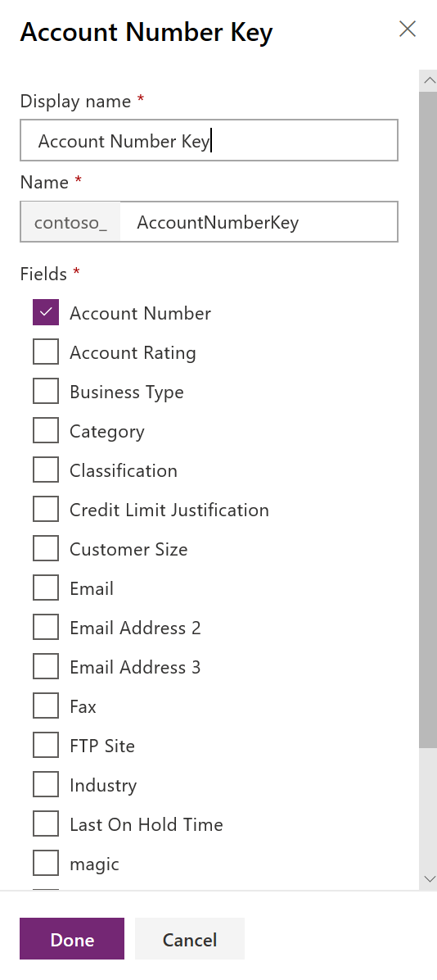
Alternate keys
Create alternate keys containing decimal, whole number and string columns
Tables can have up to 5 alternate keys
Index is created behind the scenes to enforce uniqueness
Great for use in retrieves and updates
Notes:
When a key is created, the system validates that that key can be supported by the platform, including that the total key size does not violate SQL-based index constraints like 900 bytes per key and 16 columns per key
Columns used must be “writeable”, e.g. OwningBusinessUnitId (Lookup type) won’t work
No FLS
Watch out for <,>,*,%,&,:,\\ - patch and upsert won’t work

Slide 54
Exercise: Create and add columns to a custom table
Follow the exercise in the student manual
Notes:
There are several exercises in this module. We recommend that you have students do some of them and you demo the rest.
https://docs.microsoft.com/en-us/learn/modules/create-manage-fields-within-entity/8-exercise

Slide 55

Get started with security roles in Dataverse

Slide 56
Environment
Type | Description | Security
Production | This is intended to be used for permanent work in an organization. It can be created and owned by an administrator or anyone with a Power Apps license, provided there is 1 GB available database capacity. | Full control.
Default | These are a special type of production environment. Each tenant has a default environment that's created automatically. | Limited control—all licensed users* have the Environment Maker role.
Sandbox | These are non-production environments, which offer features like copy and reset. Sandbox environments are used for development and testing, separate from production. Provisioning sandbox environments can be restricted to admins (because production environment creation can be blocked), but converting from a production to a sandbox environment can't be blocked. | Full control. If used for testing, only user access is needed. Developers require Environment Maker access to create resources.
Trial | Trial environments are intended to support short-term testing needs and are automatically cleaned up after a short period of time. They expire after 30 days and are limited to one user. Provisioning trial environments can be restricted to admins. | Full control.
Developer | Developer environments are created by users who have the Community Plan license. They're special environments intended only for use by the owner, and they can't be shared with other users. | Only a single user account with the Community Plan has access.
Notes:
Introduction to environment roles
Each environment has zero or one instance of a Dataverse database, and your organization can have many environments that are available to many different groups of users at a time. It is common practice to set up an environment so you can limit who can access the data, apps, and workflows within it.
Classic software lifecycle management provides a good use case of why you might want to set up different environments in Dataverse. Consider the following example. It is common to segment environments for development, test, and production. Dataverse allows you to set up a development environment and limit access so only developers and a few managers or test users have permission to access the data and apps in that development environment. You can then set up a test environment and set up permissions so that a few test users and developers have access to it and the data within the instance of Dataverse within that environment. Finally, you can set up production environment permissions so that a wide audience of users has access to the production environment and the data in the instance of a Dataverse database, Power Apps, and Power Automates within that production environment.
Reference https://docs.microsoft.com/en-us/power-platform/admin/environments-overview

Slide 57
Understand environment roles
System Administrator role
The System Administrator role can perform all administrative actions on an environment, including the following tasks.
Environment Maker role
The Environment Maker role can create resources within an environment such as apps, connections, custom connectors, gateways, apps that use Power Apps, and flows that use Power Automate.
Notes:
System Administrator role
The System Administrator role can perform all administrative actions on an environment, including the following tasks:
Add or remove a user or group from either the Environment Admin or Environment Maker role.
Provision a Dataverse database for the environment.
View and manage all resources that are created within an environment.
Set data loss prevention policies.
Environment Maker role
The Environment Maker role can create resources within an environment such as apps, connections, custom connectors, gateways, apps that use Power Apps, and flows that use Power Automate. The following applies to members of the Environment Maker role:
Environment Makers can distribute the apps that they build in an environment to other users within an organization by sharing the app with individual users, security groups, or to all users in the organization.
Users or groups that are assigned to these environment roles are not automatically given access to the environment's database (if it exists) and must be given access separately by a Database owner.
Whenever a new user signs up for Power Apps, they are automatically added to the Maker role of the default environment.
When you add a user to an environment, they are assigned two roles by default.
Dataverse User (this role is created when you instantiate an instance of a Dataverse database and all users in the environment are assigned this role)
Environment Maker
Demo the exercise in this lesson – Adding or disabling an environment user

Slide 58
Security model
Control access to rows:
Defines actions that users can take on rows, based on who the user is, and who owns the row
Control access to UI elements:
Forms, Dashboards, Business Process Flows
Control access to features:
Mobile, Export to Excel, Print, etc.
Simplify the user experience:
User interface will hide tables, rows and features a user does not have the privileges to use
Notes:
The Purpose of the CRM Security Model does more than provide row access. It will also define the actions that users can take on rows, based on who the user is, and who owns the row.
It also can be used to Control access to UI elements, Certain Forms, Dashboards, Business Process Flows, can be assigned to specific security roles therefore limiting who can access those items.
They also can be used to control access to specific application features, like weather someone can export information to excel, print data, or if they are allowed to use the mobile application.
The User interface will also hide tables, rows and features a user does not have the privileges to use.

Slide 59
Key security components
Business Units: Provide a framework for your organizational security structure
Privileges: Indicate what actions a user can perform on each table
Access levels: Define which rows for that table the user can perform actions upon
Security Roles: Defines the specific permissions a user or team has

Slide 60
Business units
Provide the framework for your organizational structure:
Contain Users, Teams, Security Roles
Security (data access including reports):
Define boundaries for Security Role Access Levels
First Business Unit is the “Root” Business Unit:
Created when organization is deployed, with same name as the organization
Child business units linked in a hierarchy:
Similar to an organization chart, but you do not have to replicate your organization chart – create only the business units needed to meet security needs

Slide 61
Security roles explained
Define the permissions a user or team has:
Permissions defined by privileges and access levels
All users must be assigned at least one security role
Options for assigning security roles to users:
Modify the default roles before you assign them
Create copies of the default roles as templates
Create new Security Roles, adding the privileges you require – usually only for roles with few privileges

Slide 62
Privileges
The most basic security unit in Microsoft Dynamics 365
Define what actions a user can perform on each table in the system
Examples:
Create Contacts
Read Accounts
Update Invoices
Delete Cases

Slide 63
Access levels
Access levels work in conjunction with Privileges:
Privileges indicate what actions a user can perform on each table
Access levels define which rows for that table the user can perform actions upon
Access levels are based on a combination of:
Row ownership
Business unit to which the user belongs
Notes:
These concepts are i

Slide 64
Exercise: Create and add columns to a custom table
Follow the exercise in the student manual in lesson 5
Notes:
Alternative link
https://docs.microsoft.com/en-us/learn/modules/get-started-security-roles/5-custom

Slide 65
Document and test your Power Apps application
Notes:
Link: https://docs.microsoft.com/en-us/learn/modules/use-documentation/

Slide 66

Create test plans

Slide 67
Create test plans
Unit testing – Smallest component of testing, a single unit of measure. Often this is thought to be a developer's job
Quality assurance testing – Someone independently tests the task by reviewing the expectation against the work performed
Performance testing (sometimes also referred to as load testing) – Performance or load testing is most often done using external tools
Integration testing – Did the systems we integrated with perform as expected?
User acceptance testing – This is an opportunity to have direct feedback from the actual users of the system being built
Notes:
There are many types of testing that you should consider in your deployment planning. Each of these can be done either casually, or very formally with a well-documented process to follow. Often in different deployments these will have slightly different expectations. Some testing options are manual (user adoption testing), and some are automated (load testing).
Unit testing- this is the smallest component of testing, a single unit of measure. Often this is thought to be a developer's job. However, every person on a project should include this in their work. An example of unit testing could be: You are given a requirement to add a calculated column to a form. Before you advance the task to the testing team you would confirm the column was on the form as expected and test that the calculation was as expected.
Quality assurance testing- sometimes called QA, this is when someone independently tests the task by reviewing the expectation against the work performed. Often there will be testing of the smallest components, such as the units mentioned above and also testing of a full end-to-end user story.
Performance testing (sometimes also referred to as load testing)- there are many things that can be configured that will have an impact on system performance. Sometimes the number of concurrent users affects expected performance (load); sometimes it's the combined actions of these users, and sometimes an individual user could experience problems such as a slow-loading form that has too many sub-grids. Integrations with other systems might also affect performance. Performance or load testing is most often done using external tools.
Integration testing- did the systems we integrated with perform as expected? Did we introduce unnecessary dependencies?
User acceptance testing- this is an opportunity to have direct feedback from the actual users of the system being built. User acceptance testing (hopefully) confirms the system built is the system users need.
Regardless of the exact type or plan you are using; the following considerations should be included.

Slide 68
Testing plans
Environment
Security
Dependencies
Solution Awareness
Resources
Notes:
A testing plan is an important scoping document in your project plan to communicate what will and will not be tested and necessary considerations for success. The testing plan is designed to be carried out by a technical resource to catch bugs before user acceptance testing.
At a minimum, a test plan should provide a means to test each business requirement for the project. This gives the opportunity to show that each requirement was accommodated and accomplished. When there are issues in the future, a testing plan is a helpful reference of what was tested based on understandings at the time and what may be outside the original scope. The plan needs to define the level of detail to be tested, and the process for solving and retesting any issues found.

Slide 69
Test plan components
Schedule risks:
Environmental needs
Features Tested
Testing Items
Testing Schedule
Process or fixing and Retesting failed test items
Notes:
Related Business Requirement
Steps to test
Expected result
Item pass or fail
Time and date tested
Tester name
Testing Notes
Testing Schedule
Dependencies
Timelines
Schedule risks
Dependencies
Timelines
Schedule risks
Process for fixing and retesting failed test items
A good test plan describes the intention and scope of testing, guides the technical review process and supports a smooth rollout of functionality. A test plan should proceed user acceptance testing and have a means for tracking needed changes before rollout.

Slide 70
User interface testing

Slide 71
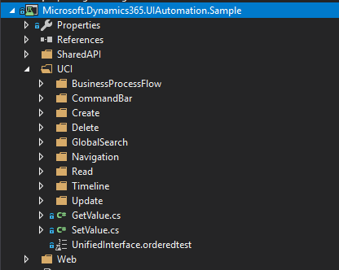
Sample tests
Over 100 standard tests for the Web Client and over 50 tests for the Unified Interface are available
Notes:
Over 100 standard tests for the Web Client and over 50 tests for the Unified Interface are available. The sample test bank covers create, retrieve, update, and delete scenarios for multiple tables including contacts, opportunities, accounts, leads, and cases. This provides you the ability to easily run and start creating customized tests using the test bank as your initial code base. You can easily access the pre-defined tests within each of the specific functional areas you are testing.

Slide 72
Performance optimization

Slide 73
Performance optimization
When analyzing performance of Dataverse, it is important to understand areas affecting the performance of an app
Notes:
When analyzing performance of Dataverse, it is important to understand areas affecting the performance of an app.

Slide 74
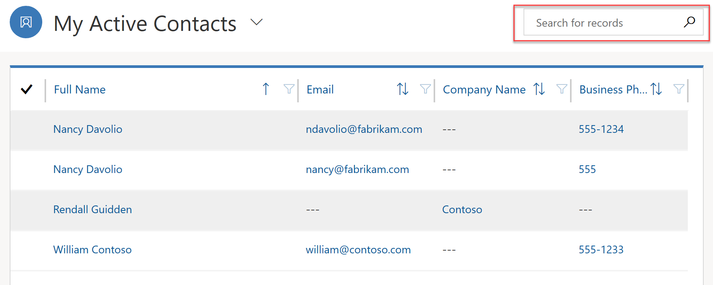
App performance
Design of the app itself can greatly affect performance
Notes:
Design of the app itself can greatly affect performance. One of the strengths of the Power platform is ability to quickly build robust small apps targeting specific users and specific functionality. Instead of a monolithic app that is more likely to suffer from performance issues you now have the ability to design several separate apps. This separation ensures that each app can be analyzed and tuned independently without too much impact on the others.
Design techniques for individual components may also affect performance of an app.
To improve form performance, design them so that only the information essential for the users is included. If information required depends on the user's role, consider creating multiple forms instead of one monolithic form that includes every single column. Hiding tabs and sections that are not required to be immediately visible can also improve form responsiveness and performance.
One of the most common sources of performance issues on the forms is custom scripts added by developers. Good collaboration within the team is a key to identify and resolve any performance bottlenecks introduced during the development.
To improve performance of the table views, limit the number of columns displayed only to those required by the business. As often the case, it's a balance between the responsiveness and bringing enough information to improve usability of the view.
Customize your views so that they bring back an actionable number of rows. For example, Active Contacts view may contain hundreds of thousands of rows while My Active Contacts will limit that view only to the contacts that are owned by the user. At the same time consider limiting the number of rows per page so that the views return much more quickly.
Optimizing the quick search view only to include columns that makes sense to search will make a noticeable performance impact on searches within the views.

Slide 75
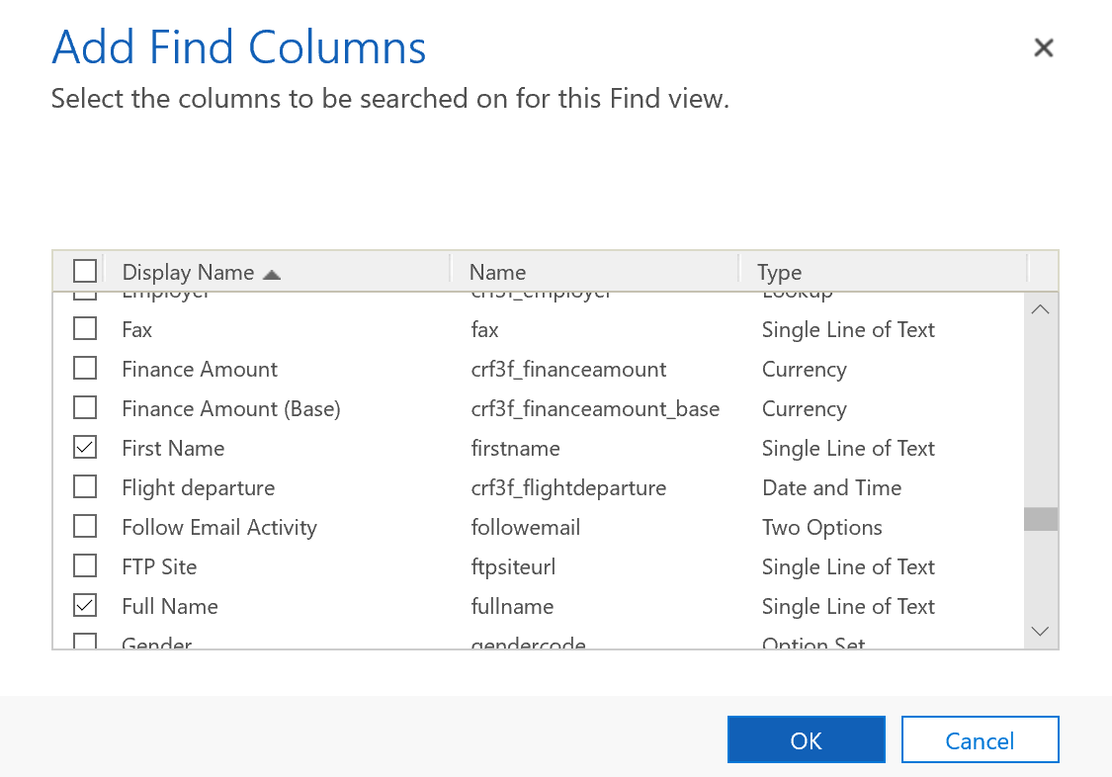
App performance
When a user searches for rows within a view, Dataverse performs a query that searches only predefined columns
Notes:
When a user searches for rows within a view, Dataverse performs a query that searches only predefined columns. Which columns are searched is defined by the Find Columns settings in the system Quick View.
The fewer number of columns that are selected, the faster quick search will be. Balance the number of find columns with the effectiveness of the search.
The primary source of performance issues in canvas apps are poorly designed data access, excessive or suboptimal formula use, and overly complex user interface.
Apps will perform poorly when most of the heavy lifting is done on the client and not on the server. Erroneous choice of how to query your data may lead to performance issues. Understanding delegationin canvas apps is the key to improving you app performance when it comes to data access.
There are some canvas apps features that you would want to consider when optimizing your app start performance by using Concurrent function to load data from multiple sources concurrently.
Another aspect that can affect performance is the number of screens and controls used in your app. Minimizing the number of controls and reducing complexity of the controls used can help boost your app performance. It will improve the performance while authoring the app as well. There are strategies to optimizing the number of controls used in your app. For example, you can use a gallery control instead of a Canvas/Data Cards when the data displayed is uniform or vary only slightly. Gallery can be powerful in reducing complexity, making your app easier to maintain.
There are other optimizations techniques available, make sure that canvas apps developers familiarize themselves with detailed documentation.
Real-time workflows can be very effective but, if designed poorly, will affect the performance of the most common operations such as creating or updating a row. Consider converting poorly performing or long running workflows to background ones where the impact on the system will be smaller.
Background workflows create a log row when an instance of the workflow is executed. The default setting is to delete log entries for successfully executed workflows. If this setting is changed to keep the entries, jobs log will grow and may reach the point where it affects performance of the asynchronous services. Only use this flag for troubleshooting and avoid leaving it on in production.
Custom extensions such as plugins are the common source of the performance issues. Work with developers to identify and resolve those.

Slide 76
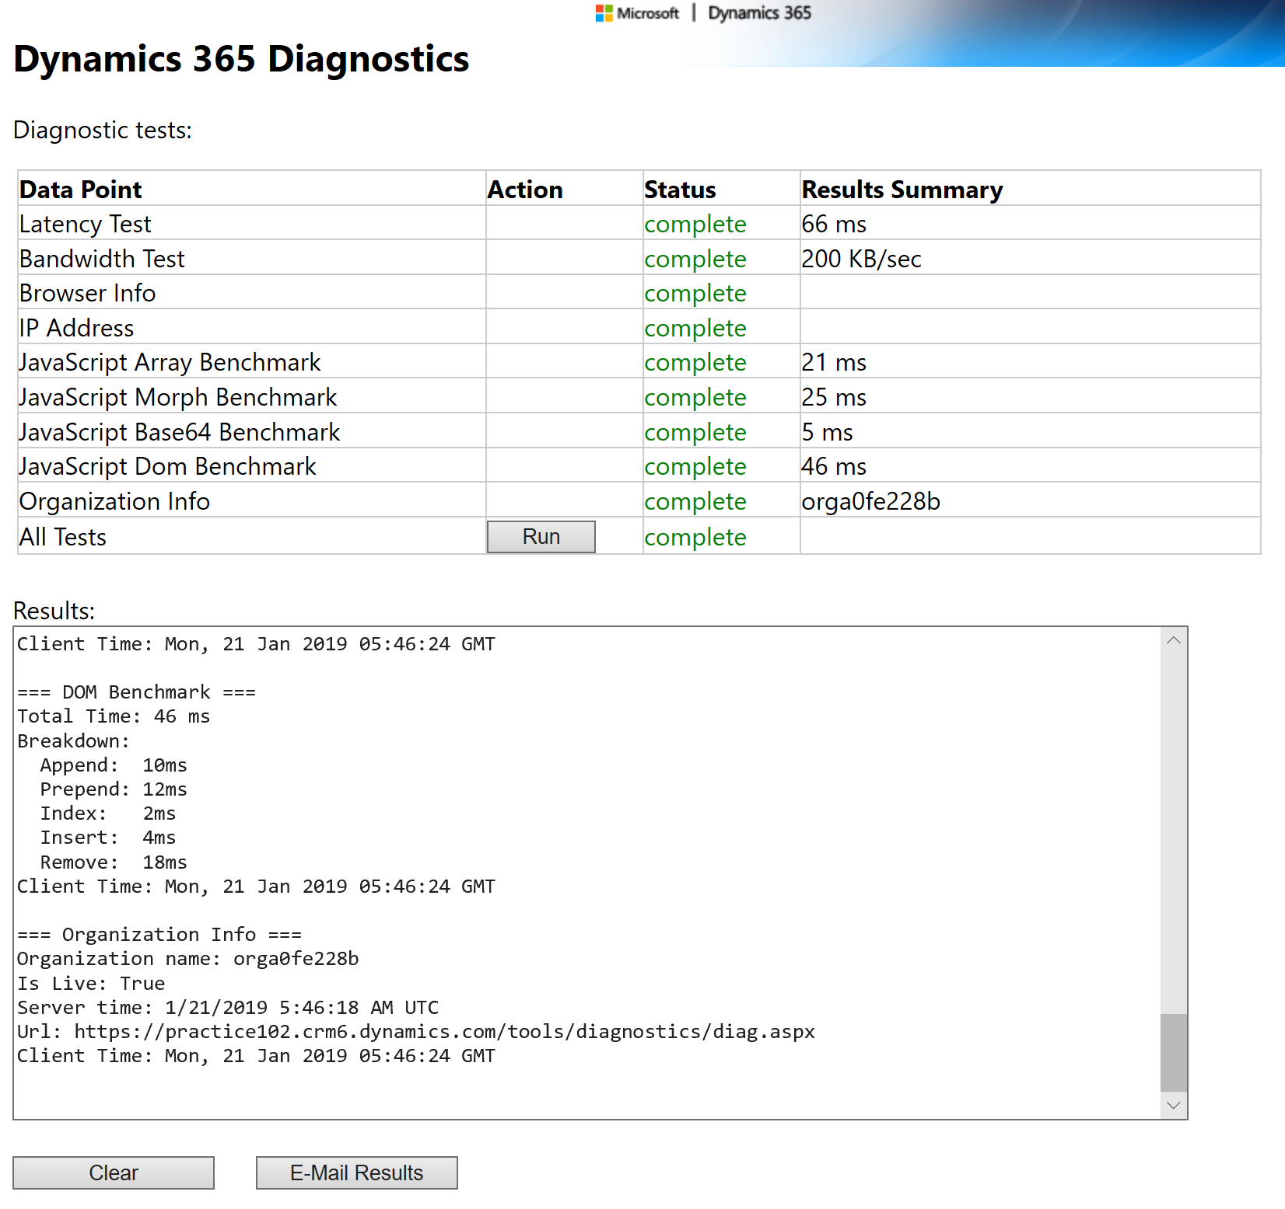
Dynamics 365 Diagnostics
There are two primary network characteristics affecting the performance: Network bandwidth and latency
Notes:
There are two primary network characteristics affecting the performance: network bandwidth and latency. Identify if these may impact your app performance, by using the Dynamics 365 Diagnostics tool that is available at https://<myorg>.crm.dynamics.com/tools/diagnostics/diag.aspx where <myorg>.crm.dynamics.com is the URL of your Dynamics 365 organization.
After opening the page and pressing Run, the report will become available that will assist your network team in detecting and resolving the issues. The statistic includes some browser benchmarks that may be useful in identifying if browser performance is an issue.

Slide 77
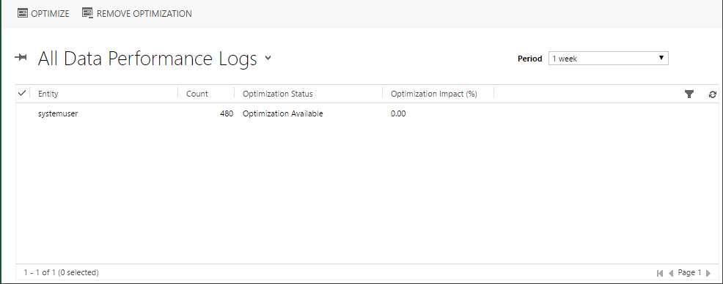
Data Performance Logs
You can analyze and optimize query performance using the Data Performance view, which provides an aggregated list of tables with long-running queries
Notes:
You can analyze and optimize query performance using the Data Performance view, which provides an aggregated list of tables with long-running queries. A long running query is defined as a query that takes three seconds or longer to complete. Typical examples of a component that can have a long running query is a plug-in with custom FetchXML or a sub-grid or view.
You can access Data Performance Logs via Settings -> Administration -> Data Performance.
If one or more long running table queries are detected, log items are displayed in the view. You can use the Optimize command to apply optimizations to the selected query.
[!Note] With the most recent advances in Azure SQL database self-tuning capabilities you may no longer see any long running queries reported in the Data Performance view. Slow queries are automatically detected and optimized at the database level.

Slide 78
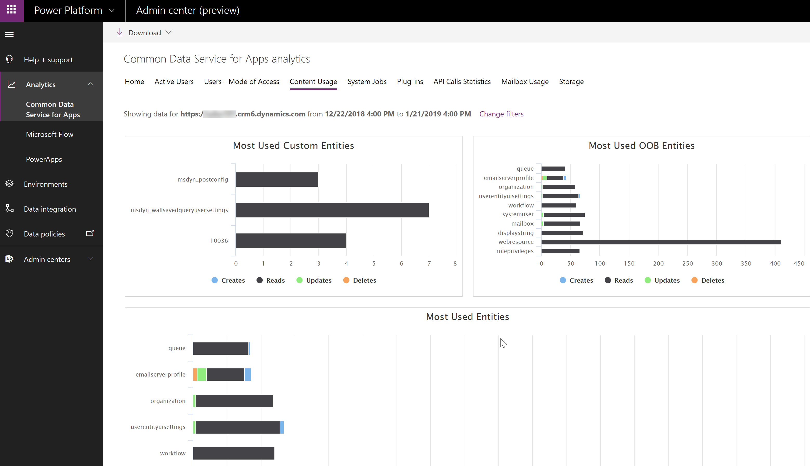
Analytics
Dataverse analytics are available via the Power platform admin center https://aka.ms/ppac
Notes:
Dataverse analytics are available via the Power platform admin center https://aka.ms/ppac. Various statistics can help identifying potential areas for deeper performance analysis.
The Content Usage tab contains information about most used out-of-the-box and custom tables. Identifying the most used tables helps concentrate the optimization efforts on the parts of the app that matter.

Slide 79
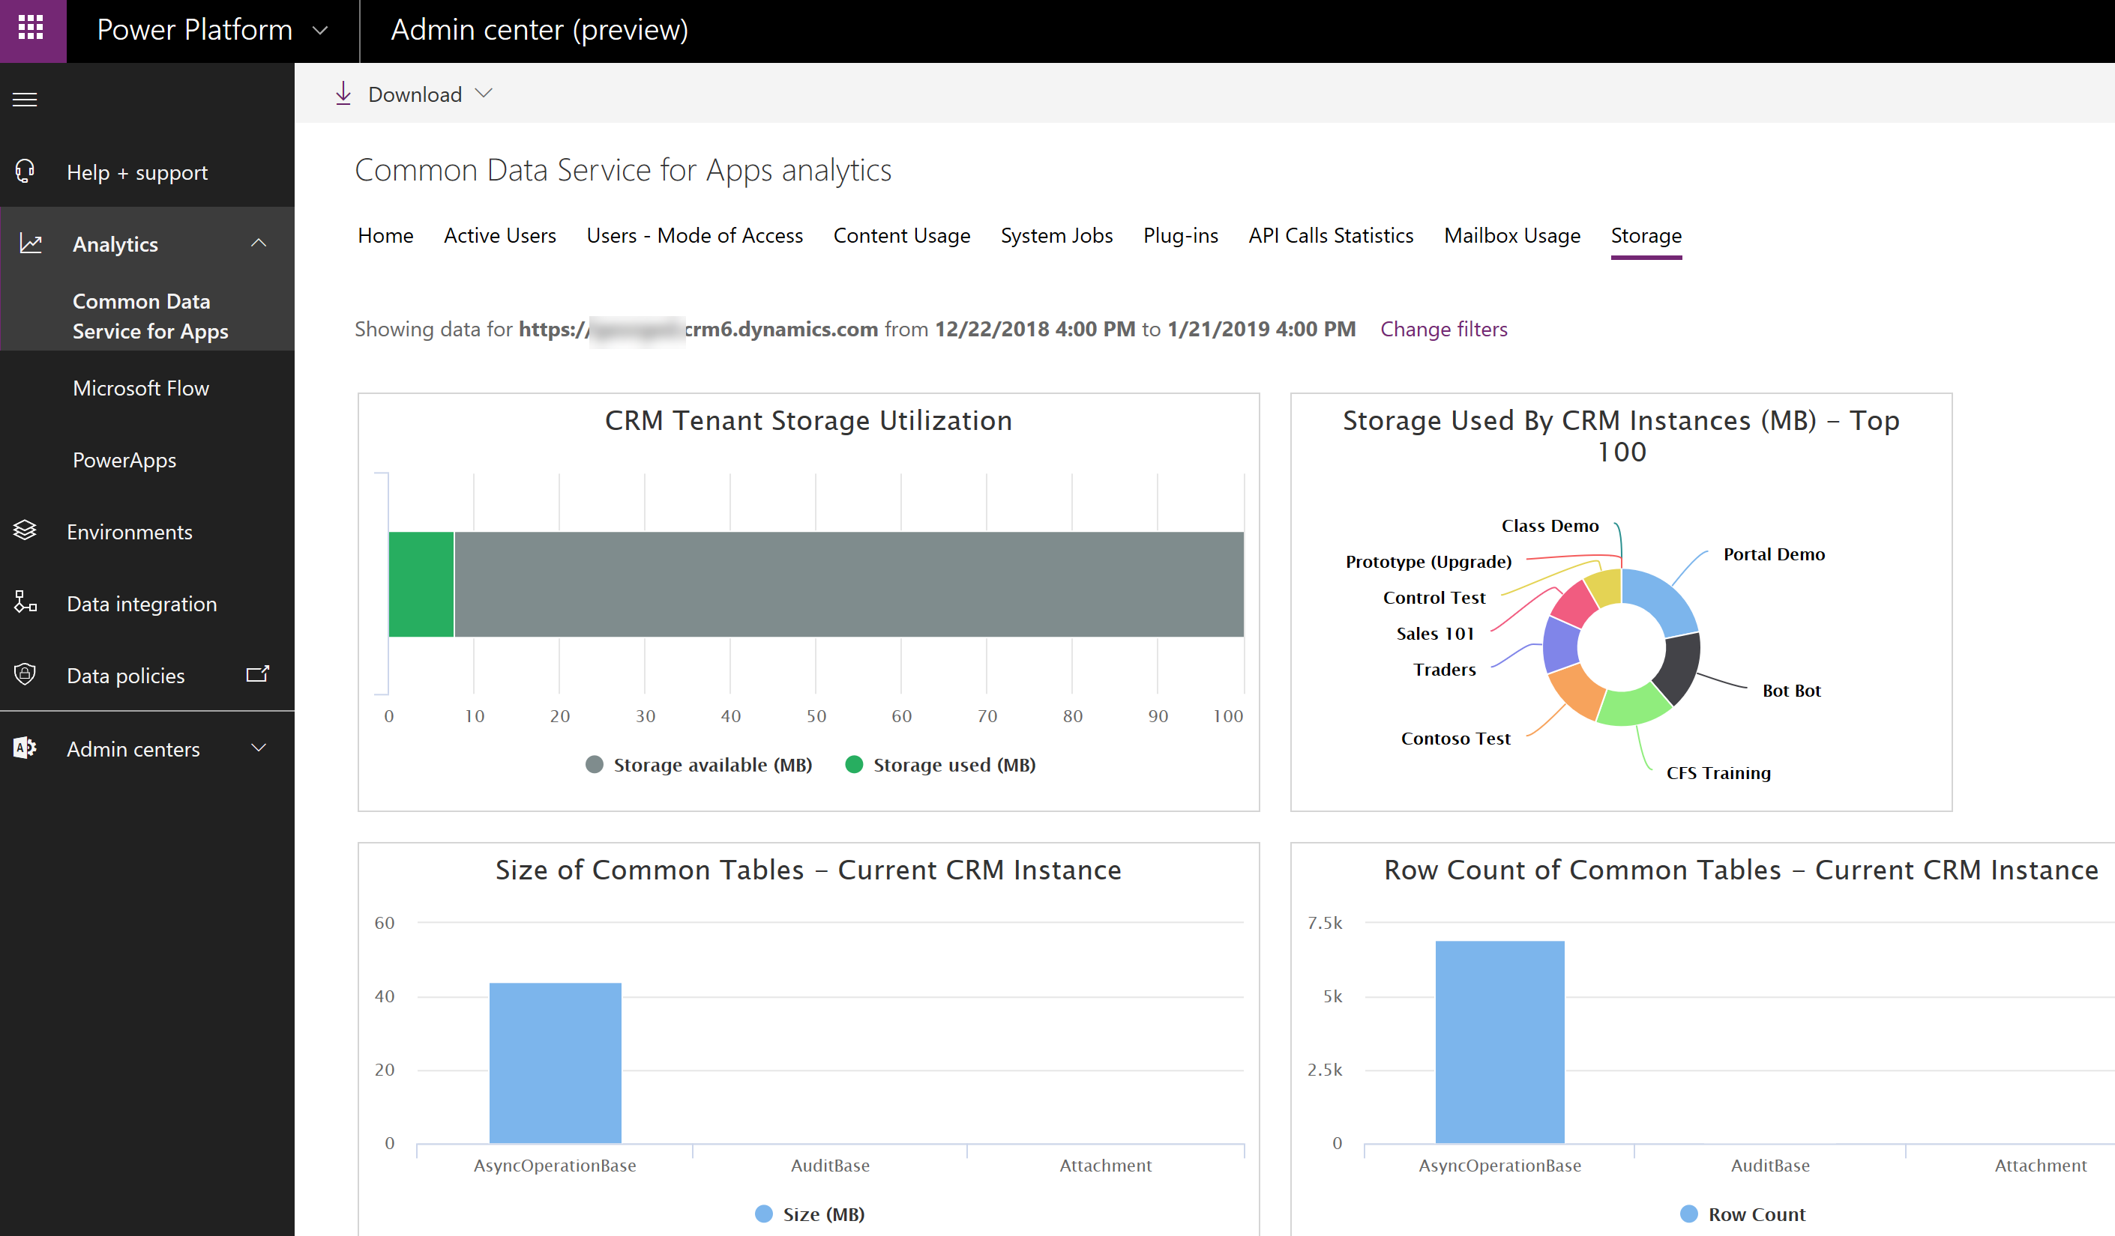
Analytics
The Storage tab provides a number of storage statistics across all of your tenant instances as well as breakdown of the storage within the selected instance
Notes:
The Storage tab provides a number of storage statistics across all of your tenant instances as well as breakdown of the storage within the selected instance.
This can help identify tables with excessive storage use that would be a primary target for further performance investigations.
Other statistics are also available that may be useful. Plug-ins statistics can assist in identifying troublesome plugins, for example those with excessive average execution time.
Power Apps Analytics help with performance analysis by providing detailed statistics on Service Performance across various connectors used in your app.
Additional information such as overall app usage, location statistics, or errors seen by end users can be extracted from other tabs. While not directly performance related, this information can be useful in pinpointing overall problematic areas that may be caused by poor app performance such as specific region, specific app, etc.

Slide 80
Documentation and the customer

Slide 81
Documentation and the customer
Types of Documentation:
Definitions
Architecture and Design
Technical specifications
End-User
Internal Marketing
Chang log
Notes:
Good documentation is key to the successful rollout of a Power Apps application. This video provides some best practices and suggestions on what to document for an app.
[!VIDEO https://www.microsoft.com/videoplayer/embed/RWs1Uz]

Slide 82
Get started with Dataverse for Teams

Slide 83
Introduction
Microsoft Dataverse for Teams is a built-in, low-code data platform for Microsoft Teams that lets users build custom apps, chatbots, and flows in Teams by using Microsoft Power Apps, Microsoft Power Virtual Agents, and Microsoft Power Automate.
Apps
Workflows
Chatbots
Dashboards
Notes:
Microsoft Dataverse for Teams is a built-in, low-code data platform for Microsoft Teams that lets users build custom apps, chatbots, and flows in Teams by using Microsoft Power Apps, Microsoft Power Virtual Agents, and Microsoft Power Automate. Dataverse for Teams, which is built on Microsoft Dataverse, provides relational data storage, rich data types, enterprise-grade governance, and one-click solution deployment to the Microsoft Teams app. This module will introduce Dataverse for Teams and how you can build apps, workflows, chatbots, and dashboards in it. You will learn how to provision Dataverse for Teams and then create a table for your data.
The four types of Dataverse for Teams solutions are:
Apps - Use Power Apps in Teams to create custom apps that are built by using the enhanced performance and scalability of Dataverse for Teams. Build custom solutions to meet your data and collaboration needs.
Workflows - Automate repetitive tasks with Power Automate in Teams. Build flows that can respond to new Teams messages when data changes in Dataverse for Teams or when a Teams message is selected and has started a process. Bring more productivity to your Teams work.
Chatbots - Respond to employee needs by building bots with Power Virtual Agents from within Teams. Share expertise through FAQs and interact with your data in Dataverse for Teams.
Dashboards - Present powerful interactive charts and data with Power BI in Teams. Users can explore and interact with their data in Dataverse for Teams.

Slide 84
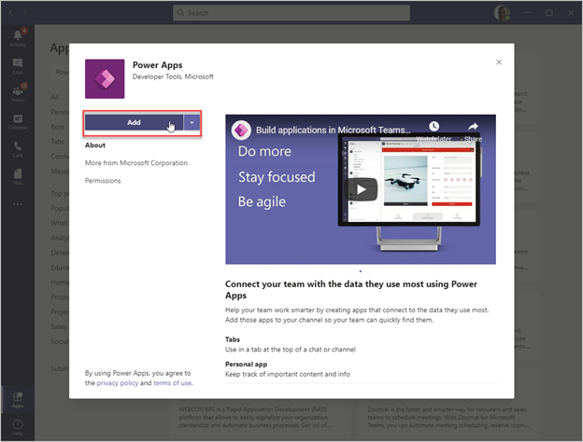
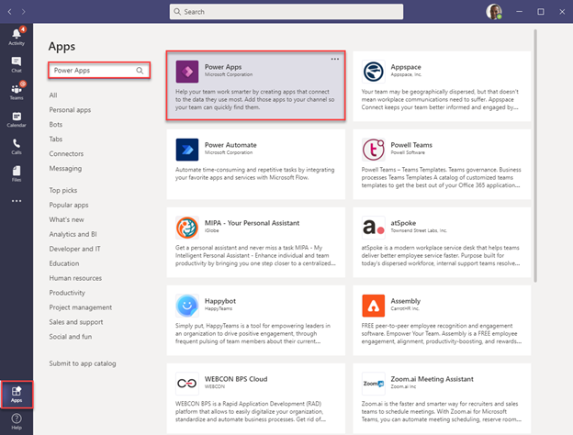
Install Power Apps inside Teams
The Power Apps application for Teams lets you create, edit, and delete apps and tables in Dataverse for Teams.
Notes:
Provision your first Dataverse environment
The Dataverse for Teams environment is where all business data, apps, and flows are stored. Each environment is associated to a Microsoft Office 365 group for the team. For this reason, each team can only have one Dataverse for Teams environment. When an app or chatbot is created or installed for the first time into a team, the Dataverse for Teams environment is provisioned automatically. After the environment has been created, you can create tables and flows in Dataverse.
The Power Apps application for Teams lets you create, edit, and delete apps and tables in Dataverse for Teams. To provision the Dataverse for Teams environment, you first need to install an app into Teams.
To get started, open Teams and look for the Apps button in the lower-left corner of the window.
On the App Marketplace screen, use the search box to find Power Apps. Select the app labeled Power Apps.
[!div class="mx-imgBorder"] Screenshot of the Power Apps install button in Teams.
Select the Add button to add the Power Apps application to your Teams client.

Slide 85
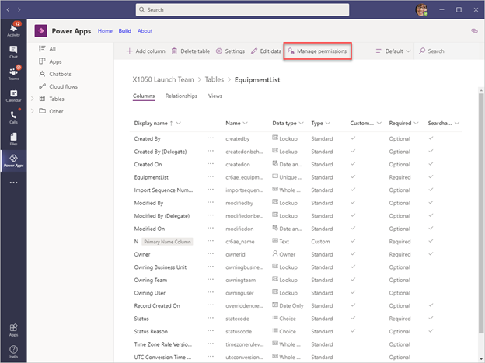
Get started with Dataverse for Teams
Notes:
Follow the steps in the links:
https://docs.microsoft.com/en-us/learn/modules/get-started-dataverse-teams/2-provision-environment
https://docs.microsoft.com/en-us/learn/modules/get-started-dataverse-teams/3-create-table

Slide 86
Build your first app with Dataverse for Teams

Slide 87
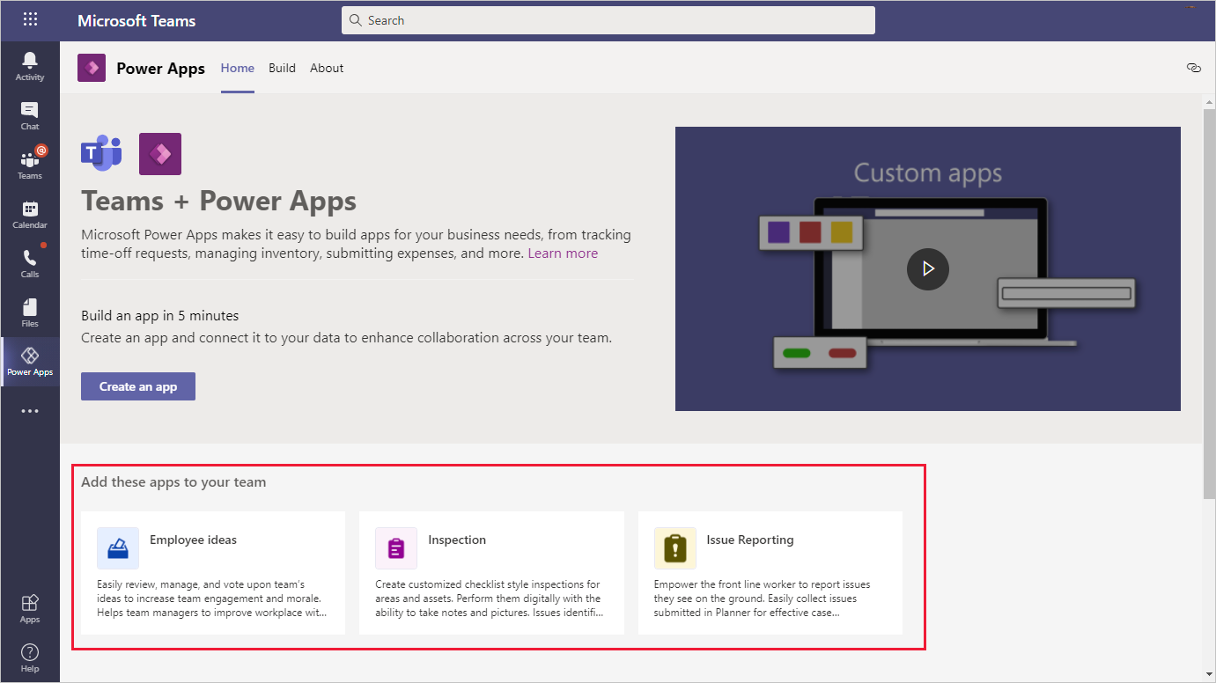
Build your first app with Dataverse for Teams
Notes:
Follow the steps in the learning path:
https://docs.microsoft.com/en-us/learn/modules/build-app-dataverse-teams/

